Slide 1



S12: Exploring Nutritional Psychiatric Guidelines for a Clinical Trial on Natural Products in Children with ADHD: A Focus on Biological Sample Collection
Hayleigh Ast, ND; Jeanette Johnstone, PhD, MA; Taryn Machingo, ND, MS; Lydia-Norby-Adams, BA
The SNACK Lab at Oregon Health & Science University ​
Helfgott Research Institute National University of Natural Medicine
Notes:
Welcome to our presentation. We’re all excited to be here. SNACK = Science of Nutrition Affect and Cognition in Kids

Slide 2
Outline
MADDY Study
ISNPR Guidelines
Implementation in the MADDY Study
Blood Sampling: Plasma Immune Factor Analysis
Stool Collection: Gut Microbiome & Metabolome Analysis
Urine Collection: Glyphosate Analysis
ISNPR: International Society for Nutritional Psychiatry
MADDY: Micronutrients for ADHD in Youth

Slide 3
No financial conflicts to declare
Studies were funded by unrestricted philanthropic gifts
Manufacturers provided the formulas, but had no input in the studies themselves or their reporting ​
We have no commercial interest in any company or product.​
Notes:
We do not have any conflicts of interest. The active capsules and placebo were provided by the manufacturers, who had no say in the data collection, interpretation or reporting. We will be talking about sample collection done in our research study, and may mention specific devices or products that we've used, but are not intending to promote any particular brand.

Slide 4


Micronutrients for ADHD in Youth Study (MADDY)
Notes:
I took off the date because it seems like an "old" study – you can just mention that it was completed a few years ago; data generation and analyses from biological samples is happening currently.

Slide 5
Methods of MADDY (N=126)
Multinutrients (or micronutrients)
  Essential vitamins, minerals, amino acids and antioxidants
Double Blind, RCT
Age: 6-12 year olds with ADHD
N=126
Collected biological samples
Johnstone et al. JAACAP 2022

Slide 6
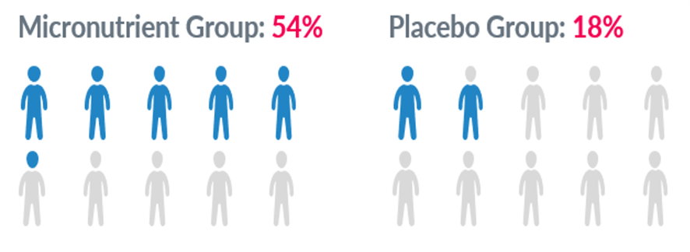
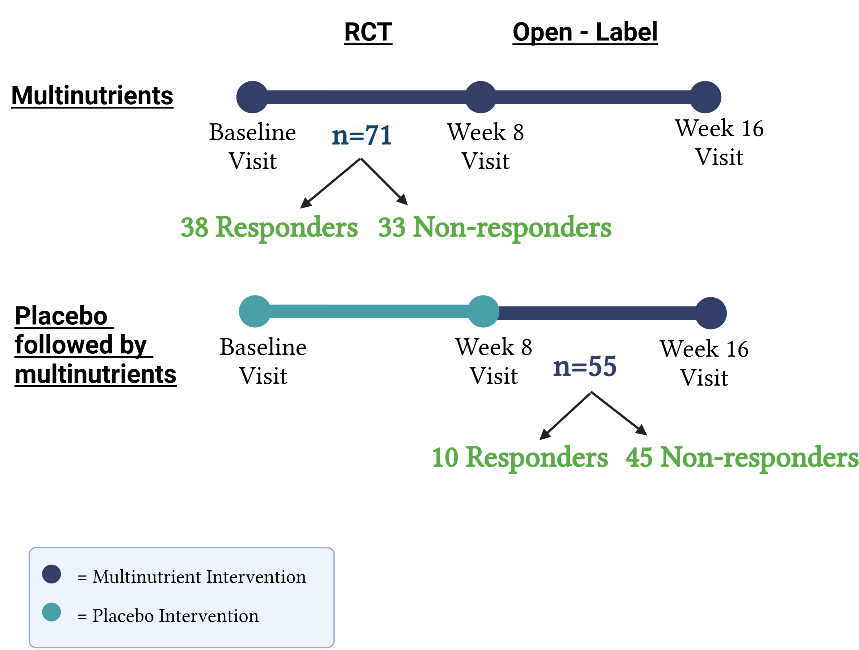
Study Design (N=126)
Johnstone et al. JAACAP 2022

Slide 7
Study Guidelines
International Society for Nutritional Psychiatry
NIH K23, Associate Professor
Jeni Johnstone, PhD, MA

Slide 8
International Society for Nutritional Psychiatry Research (ISNPR)
ISNPR Mission Statement:
To advance scientifically rigorous research and the pre-clinical, clinical, and public health implementation of nutritional approaches to help prevent and treat mental health disorders and their comorbidities.
Marx et al., British Journal of Nutrition (2024) Methodological and reporting recommendations for clinical trials in Nutritional Psychiatry: Guidelines from the International Society for Nutritional Psychiatry Research
http://www.isnpr.org/
Notes:
Aims of the ISNPR are to grow the field of nutritional psychiatry research and facilitate knowledge translation (promote events/meetings, special edition journal issues, translate evidence into policy and clinical practice

Slide 9
Delphi Process
Step 1: Expert Panel – A group of experts or knowledgeable people in a specific field are selected. These could be clinicians, researchers, or specialists with relevant experience.
Step 2: Anonymous Questionnaires – Each expert is asked to answer a series of questions or give their opinion on a particular issue. The goal is to gather their individual views without influence from others.
Step 3: Round 1 – Experts provide their initial responses. These answers might be broad or varied.
Step 4: Summary Feedback – After the first round, the responses are summarized. The feedback is shared with the group, showing trends, common points, or differences. Experts can see how their opinions compare to others.
Step 5: Round 2 (and sometimes more) – Based on the feedback, experts are asked to reconsider their answers or adjust them in light of the group’s collective input. This process can continue over several rounds.
Step 6: Consensus – Over the rounds, experts refine their opinions, and the group begins to reach a consensus on the best approach or solution to the issue.
Notes:
Why is it useful for clinicians and researchers?
Reduces bias: Experts contribute independently, so their views aren't swayed by others.
Inclusive: It allows for input from a diverse range of experts.
Structured: It helps organize complex or unclear issues into more focused solutions.
Effective in uncertain areas: Especially useful in areas where evidence is limited or where expert opinion is needed to guide decisions.
In simple terms, think of the Delphi process as a structured way to get the best possible input from experts in order to make more informed, agreed-upon decisions in research or clinical practice.

Slide 10
Clinical Trial Guidelines
Delphi Process – 18 researchers
61 recommendations;
  49 for trial design
  5 for trial reporting
  7 for future research
Marx et al., 2024 British J of Nutrition
Notes:
Delphi process with 18 researchers who have considerable clinical trial experience in either methodology, nutraceutical or dietary interventions in psychiatry.
Multidisciplinary team and co-design processes into the design and conduct of the research, methods to improve transparency and replicability as well as common biases in nutrition trials. Guidelines are intended to improve the rigor and clinical relevance of ongoing and future clinical trials in Nutritional Psychiatry.
the rigor and clinical relevance of ongoing and future clinical trials in Nutritional Psychiatry

Slide 11
Recommendations

Slide 12

Recommendations: Study Team
Multidisciplinary team
Engage individuals with lived experience
Registered dieticians for dietary studies
Notes:
Multidisciplinary team – clinicians, research staff, statistician, someone to generate the data and to INTERPRET it
Get input from folks who have lived experience of what you're studying (mental health disorder, parents) – community engagement
For dietary studies – include RDs rather than clinicians or general staff – trained in counseling, motivational interviewing to bolster intervention; and if counseling or MI is used consider the potentially independent influence on study outcomes

Slide 13

Recommendations: Trial Design
Consider participant burden, potential adherence barriers
Predefine adherence assessment methods
Multimodal data collection methods
Mitigate expectancy bias
Ensure adequate power
Specify sufficient dose / duration
Account for seasonal variation
Notes:
Predefine adherence assessment methods and thresholds
Dietary data – use food models, cross checkign with participants, pictures of meals
Qualitative + quantitative, Ecological Momentary Assessment
Mitigate expectancy bias – all hypotheses are of equal interest, limit participant exposure to intervention details (Mindfulness Study); measure participant expectation in advance

Slide 14

Recommendations: Participants
Use recruitment strategies to enhance sample generalizability to broad population
For dietary studies, establish clear protocols for participants with eating disorders
Enroll participants with sufficient "disorder" to avoid potential floor effect
Use accepted cut-offs for eligibility criteria
Account for comorbidities
Notes:
Account for comorbidities within the eligibility criteria and document, interpret outcomes
In multinutrient studies, child had to be able to swallow pills and we provided a video and training beforehand
If they're not sick, they may not get better/improve
eligibility criteria – structured interviews are ideal, otherwise validated measures with pre-determined cut offs

Slide 15

Recommendations: Interventions
Manualize diet or behavioral interventions; test for fidelity / adherence
Dietary interventions – provide guidance on food safety, hygiene, storage, preparation, especially if introducing unfamiliar foods
Ensure tailored delivery to the population
In rural or remote areas – ensure ingredient availability, and/or transport is available
Notes:
Dietary interventions – weight-neutral designs (unless specifically a weight loss focus)
Also consider role of food insecurity; ask about it
Ensure tailored delivery to the population – consider age, culture, gender, attention span (toys / fidgets for kids), EMA behavior responses: frequency, duration, impairment

Slide 16
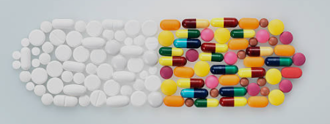
Recommendations: Placebo or Comparator
Justify and explain comparison condition
Use a placebo, not a waitlist
Match expectancy and engagement in the control
Consider non-inferiority trial designs for current treatments
Notes:
NCCIH is not accepting waitlist control as a fundable proposal
Nutraceuticals (multinutrients) - matched placebo (size, color, riboflavin to color urine); placebo diets; be sure trial/study materials sustain blinding
Where blinding is difficult, match the expectancy (give rationale why either approach/intervention/treatment might work), same level of engagement (control for time)
non-inferiority trial designs for current treatments (CBT, pharmacotherapy)

Slide 17

Recommendations: Outcomes
Use self- and clinician-rated outcomes
Measure at multiple timepoints; EMA
Use total scores and individual symptom changes
Include relevant biological samples
Consider subgroup analyses
Measure safety
Notes:
Outcomes – could be parent, teacher, spouse; be sure the measure is valid for the age/type of person answering.
Biological samples – which we are focused on here; dietary interventions, could be cholesterol or metabolic measures
For all of these Use assessment tools validated for the target population and contextualize the change within the established minimum clinical differences

Slide 18
Recommendations: Reporting Outcomes
Measure dose, frequency, composition, timing of the intervention
Define, a priori, primary outcomes
Clearly delineate extent of industry involvement
Authors declare conflicts of interest / bias
Make trial protocols publicly available
Notes:
Trial protocols: publish the study protocol, post on an online repository; in the US, clincialtrials.gov sets a high standard for researchers

Slide 19

Recommendations: Future Research
Consider diverse research settings: inpatient and outpatient, different healthcare environments
Test over-the-counter formulas or popular diets (e.g.ketogenic) that have limited clinical data
Conduct scaleable research (virtual, group-based)
Examine treatment effect moderators
Include under-researched populations
Notes:
Future for efficacy trials, consider real-world treatment effectiveness and implementation trial designs

Slide 20
Summary
Build a diverse research team
Use these guidelines

Slide 21

International Society for Nutritional Psychiatry Research (ISNPR)

Slide 22
Blood Sampling
Plasma Immune Factor Analysis
NIH T32 Post-doctoral researcher ​
Taryn Machingo, ND, MS

Slide 23
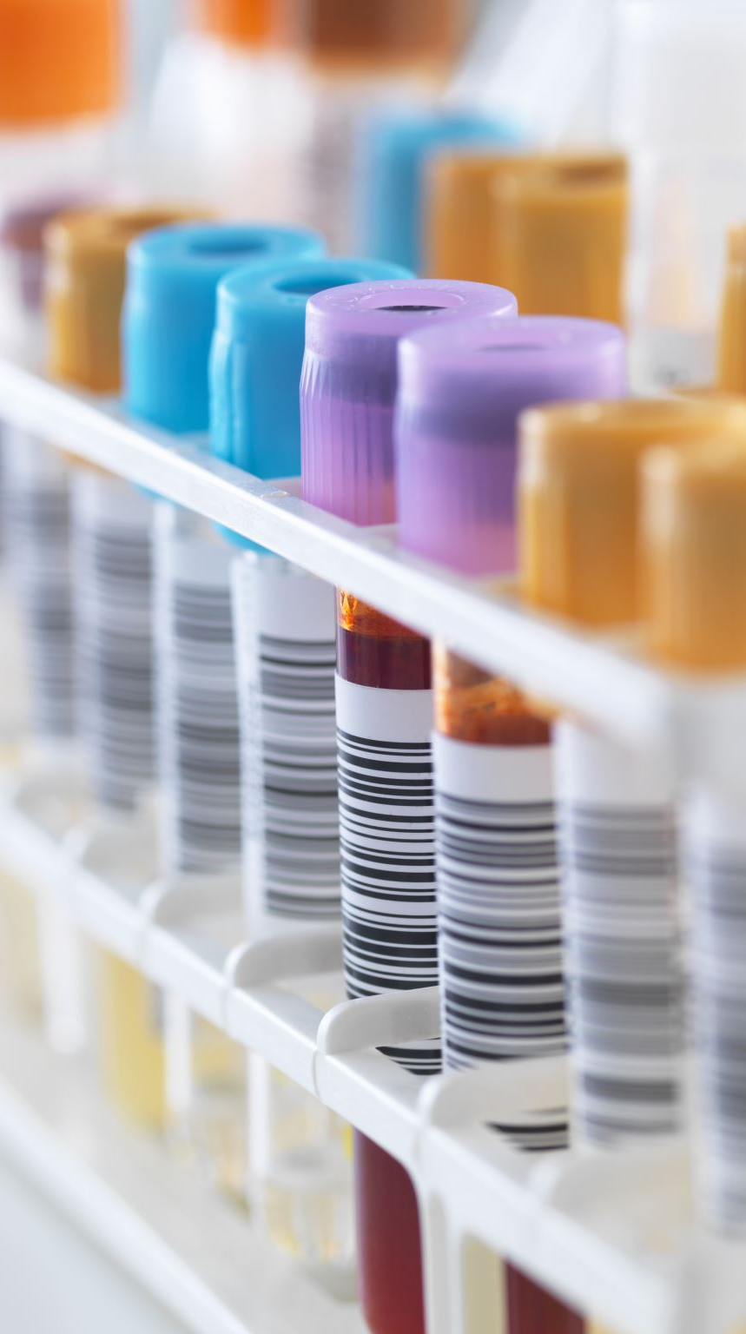
Blood sample collection
Blood samples are the most commonly collected bio-specimens
Anticoagulants
  EDTA, heparin, citrate
    Complete blood count
Serum separation
  Comprehensive metabolic panel
Storage
  2 to 8 degrees Celsius or –20 to –80 degrees Celsius
  Protected from direct light exposure

Slide 24
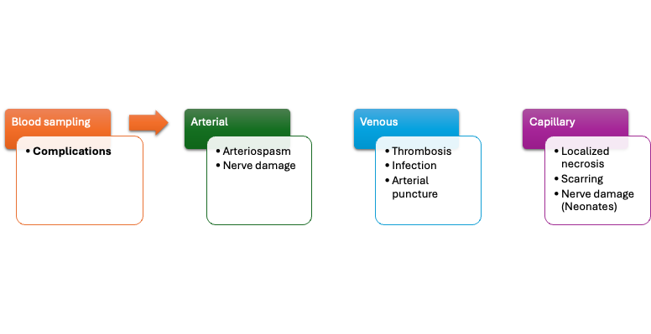
Vasovagal response
Hematoma

Slide 25
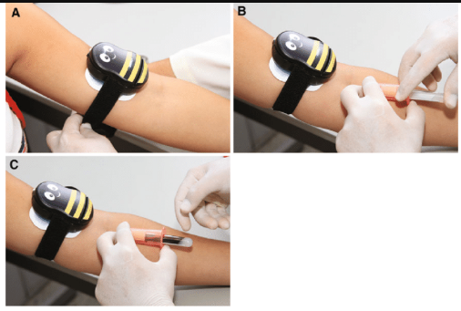
Pain & anxiety relief during specimen collection
Application of external cold and vibration via Buzzy®
Decreased perceived pain and anxiety
Few clinically significant differences between samples that did and did not use Buzzy®
^{Alternative use as distraction}
Notes:
We used the Buzzy Bee in the MADDY study

Slide 26
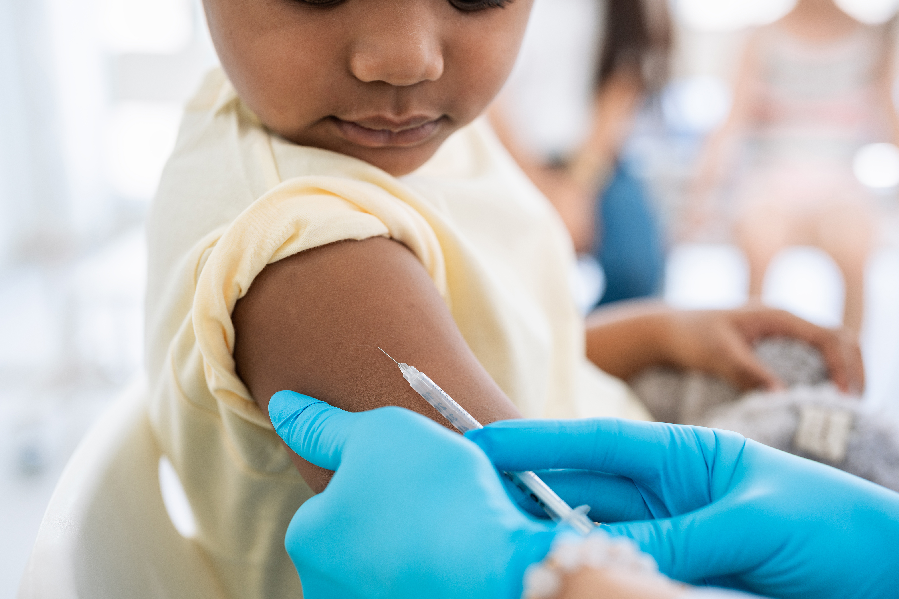
Use of upper arm based capillary blood collection devices
Patients prefer this collection method to traditional venipuncture
Concordance between venous and capillary samples was high
Notes:
Remote self-collection of capillary blood using upper arm-based devices for autoantibody and CRP analysis in patients with autoimmune rheumatic diseases is feasible, accurate and well accepted among patients.

Slide 27
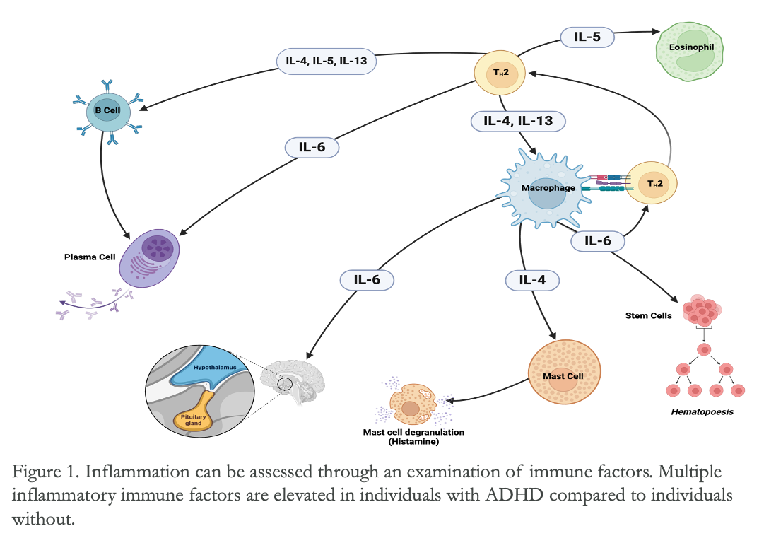
Baseline association of Suicidality with pro- and anti-inflammatory immune factors in children with ADHD
Created with Biorender.com
Notes:
T-helper 2 pathway also associated with allergies, asthma, eczema (and ADHD)

Slide 28
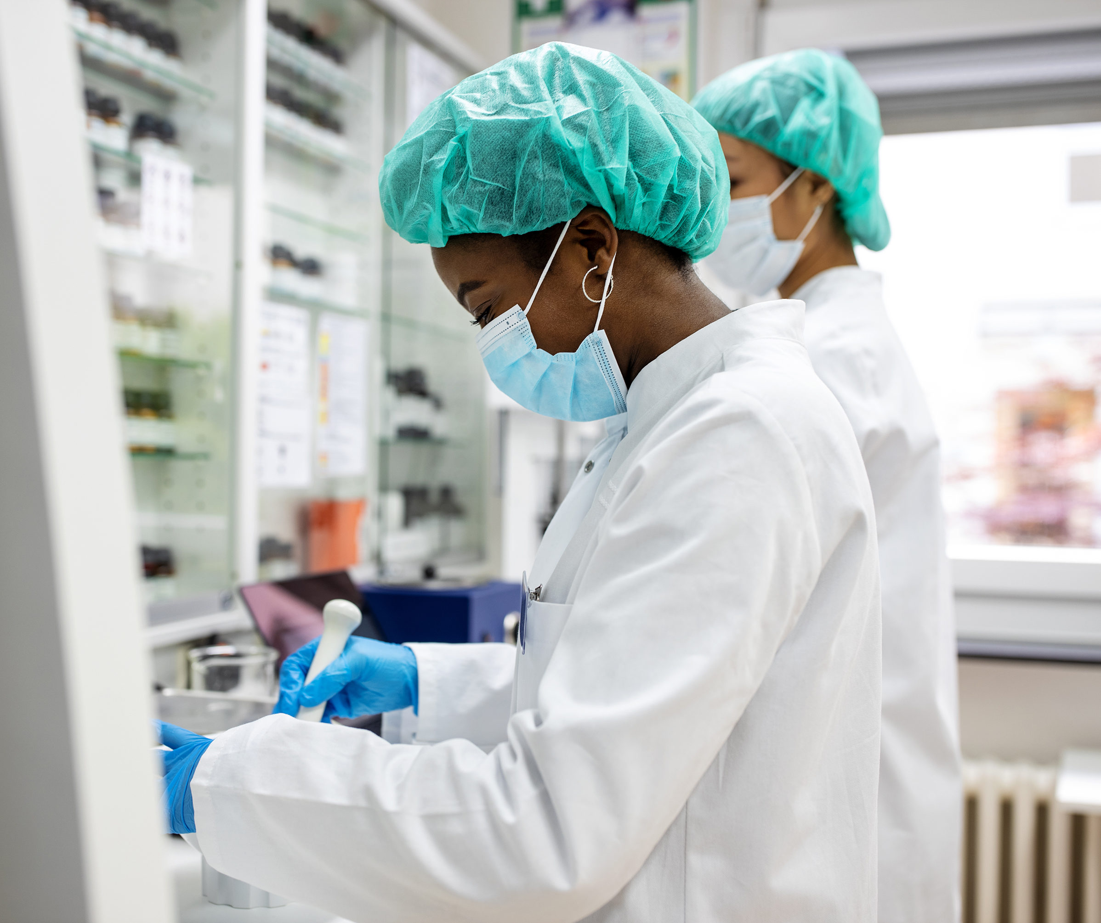
Baseline association of Suicidality with pro- and anti-inflammatory immune factors in children with ADHD
Methods:
19 immune factors were analyzed
    Known role in psychiatric pathology
Plasma immune factor concentrations were measured using multiplex assays on a Luminex LX-200 instrument
Panels
    Cancer Multiplex Assay
        HAGP1MAG-12
      leptin, human growth factor (HGF), and vascular endothelial growth factor-A (VEGF-A)
    Immunology Multiplex Assay
        HCYTOMAG-60K
Notes:
What does the Cancer Multiplex Assay refer to?

Slide 29
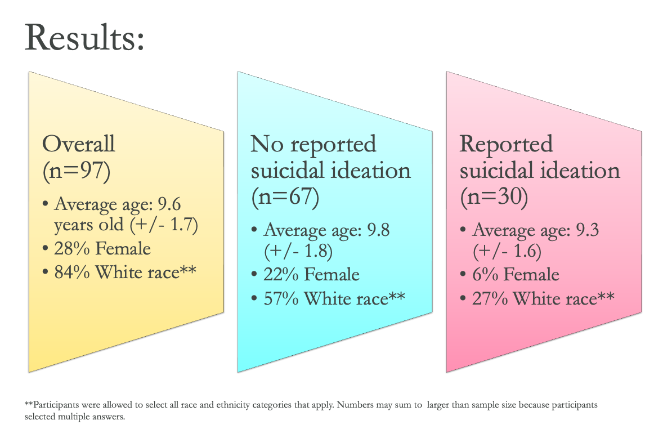
Baseline association of Suicidality with pro- and anti-inflammatory immune factors in children with ADHD
Notes:
It would be good to highlight that 30% of the children 6-12 endorsed some level of suicidal ideation

Slide 30
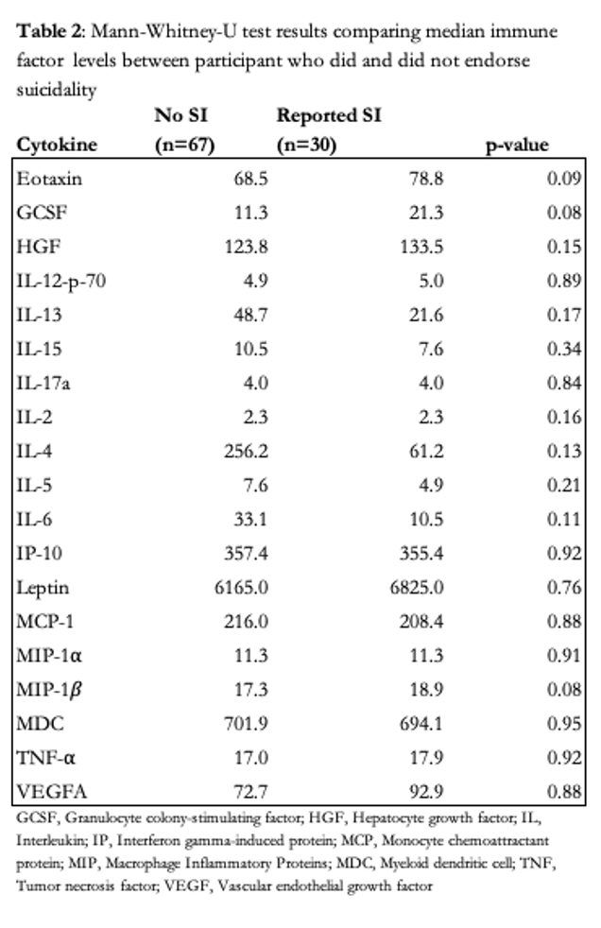

Several immune factors (eotaxin, GCSF, MIP-1β) showed a trend toward statistical significance, suggesting a possible difference between groups that warrants further investigation. This would require a larger sample size and a more age-appropriate screening tool for suicidal ideation.
Notes:
I would focus on the 3 immune factors that showed a trend. Make them stand out a bit. You can omit the word, "several immune factors" and just name the 3 factors. Omit as many words as you can in the box so that those who read slides can see the main point. :)

Slide 31
Stool Collection
Gut microbiome and metabolomic response to micronutrients in children with ADHD

Slide 32
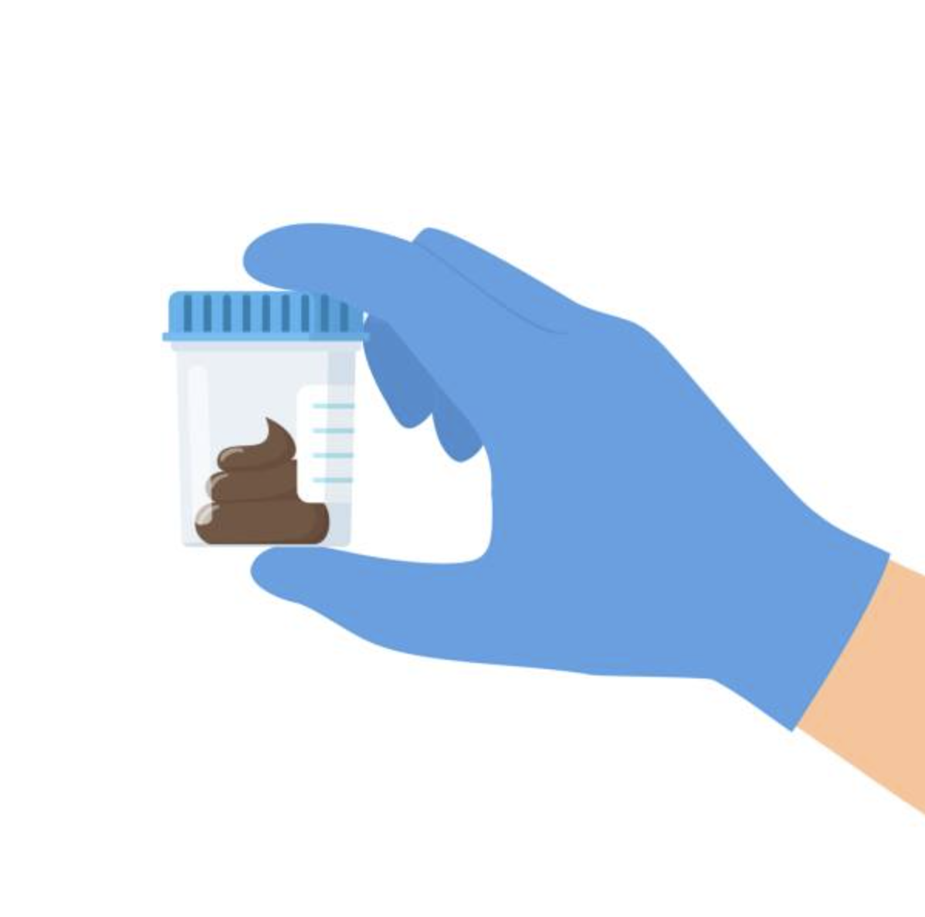
Sample Collection
Stool samples collected using OMNIgene-gut collection kits at home
  Kits offer stabilization of fecal DNA and RNA at room temperature.
3 timepoints
  Baseline
  Week 8 (RCT end)
  Week 16 (open label extension end)

Slide 33
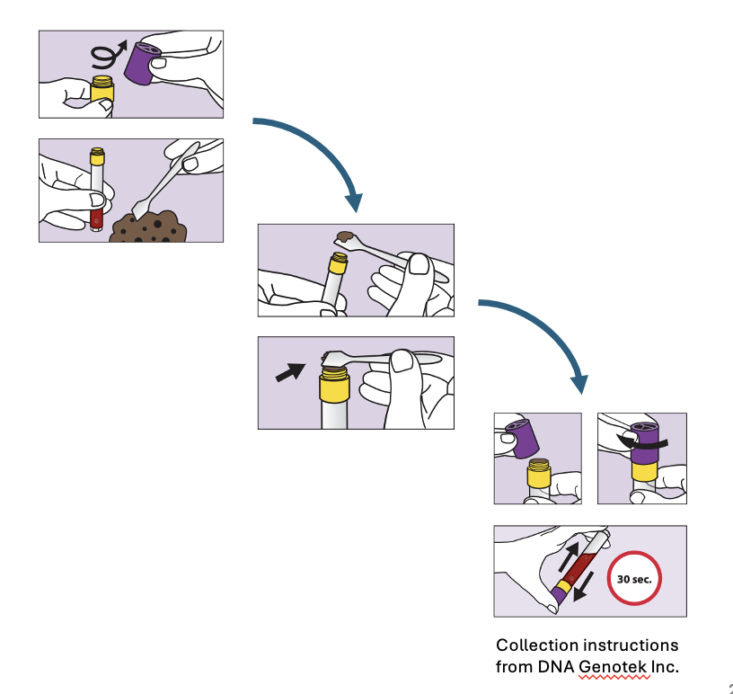
Procedure
Stool samples collected at home in all MADDY participants
Instructed to place sample in test tube.
Tubes shaken to stabilize.
Samples returned at next visit (within 1 month) and immediately stored at -80ºC until analysis.
    Stability – 30 days for metabolites and 60 days for microbiome.
Notes:
Collected stool into a paper tray or a plastic "hat" that went over the toilet bowl – keep toilet water out of the sample

Slide 34
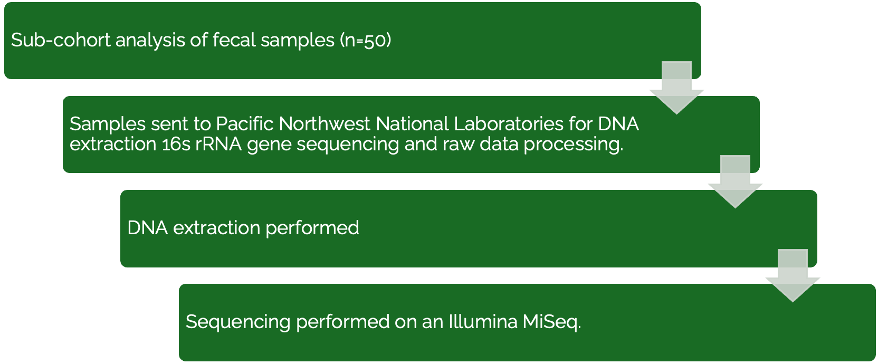
Microbiota data generation and processing
Notes:
Just a suggestion, can you change the color of the rectangles to match the colors in the slide template?

Slide 35
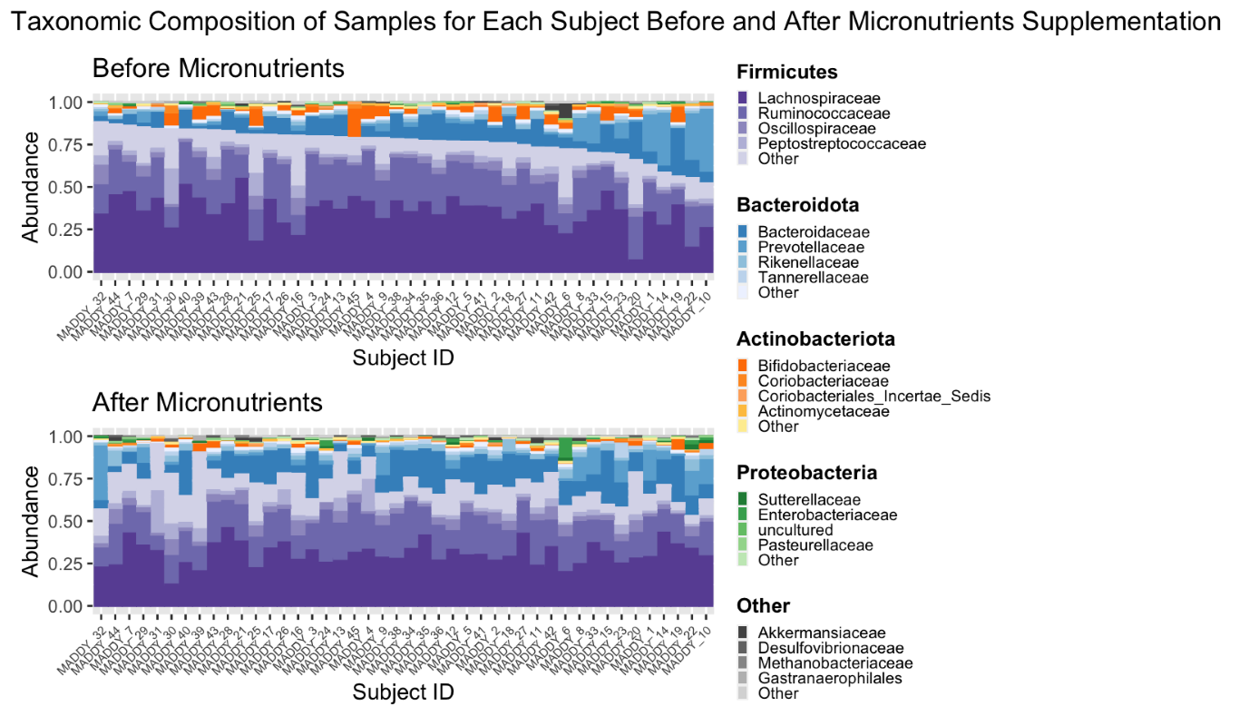
Microbiome Results
Ast et al. Gut Microbes 2025
Stevens et al. Scientific Reports 2019

Slide 36
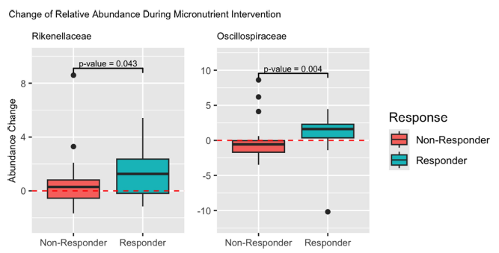
Ast et al. Gut Microbes 2025

Slide 37
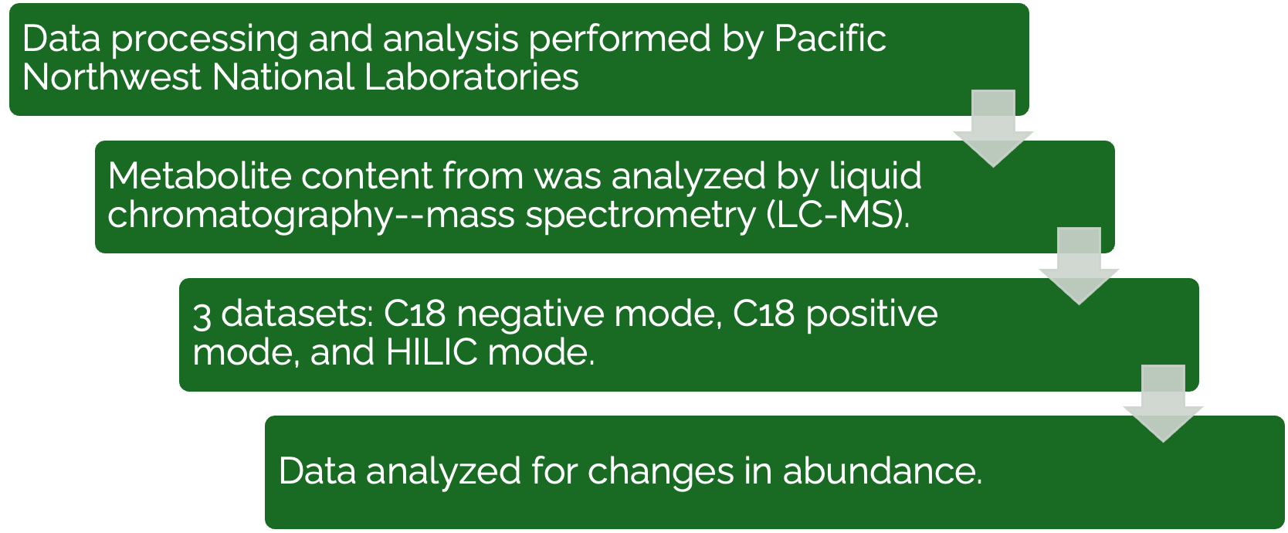
Metabolite identification and analysis
Notes:
Just a suggestion, can you change the color of the rectangles to match the colors in the slide template?

Slide 38
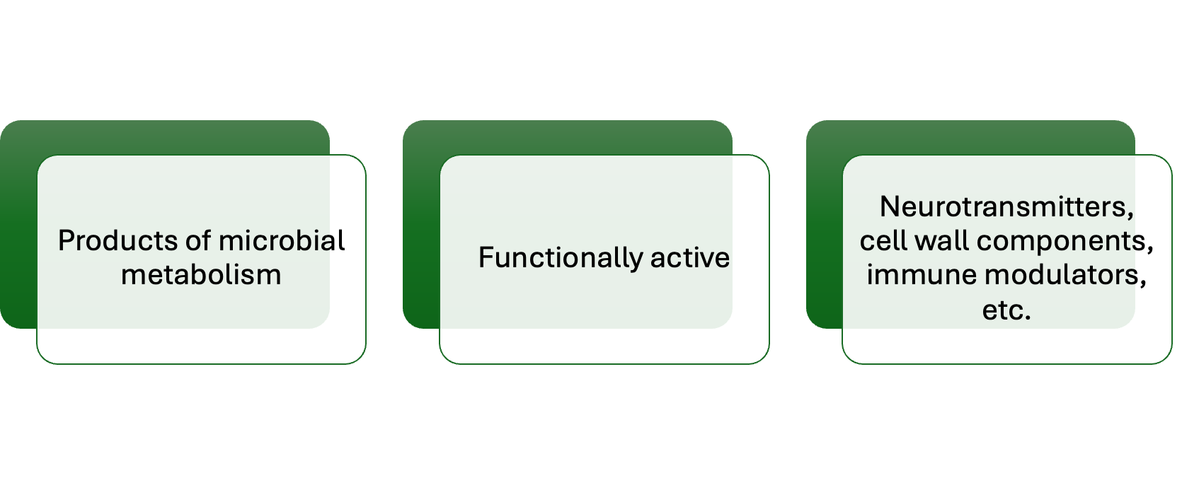
Metabolite Analysis

Slide 39
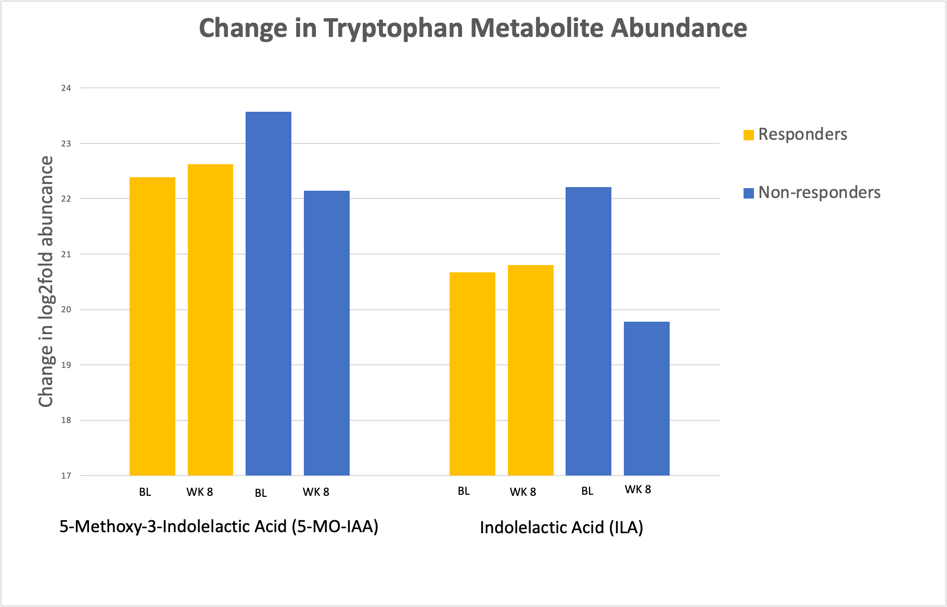

Slide 40
Urine Collection
Urinary Glyphosate Analysis
NIH T32 Post-doctoral researcher
Hayleigh Ast, ND

Slide 41


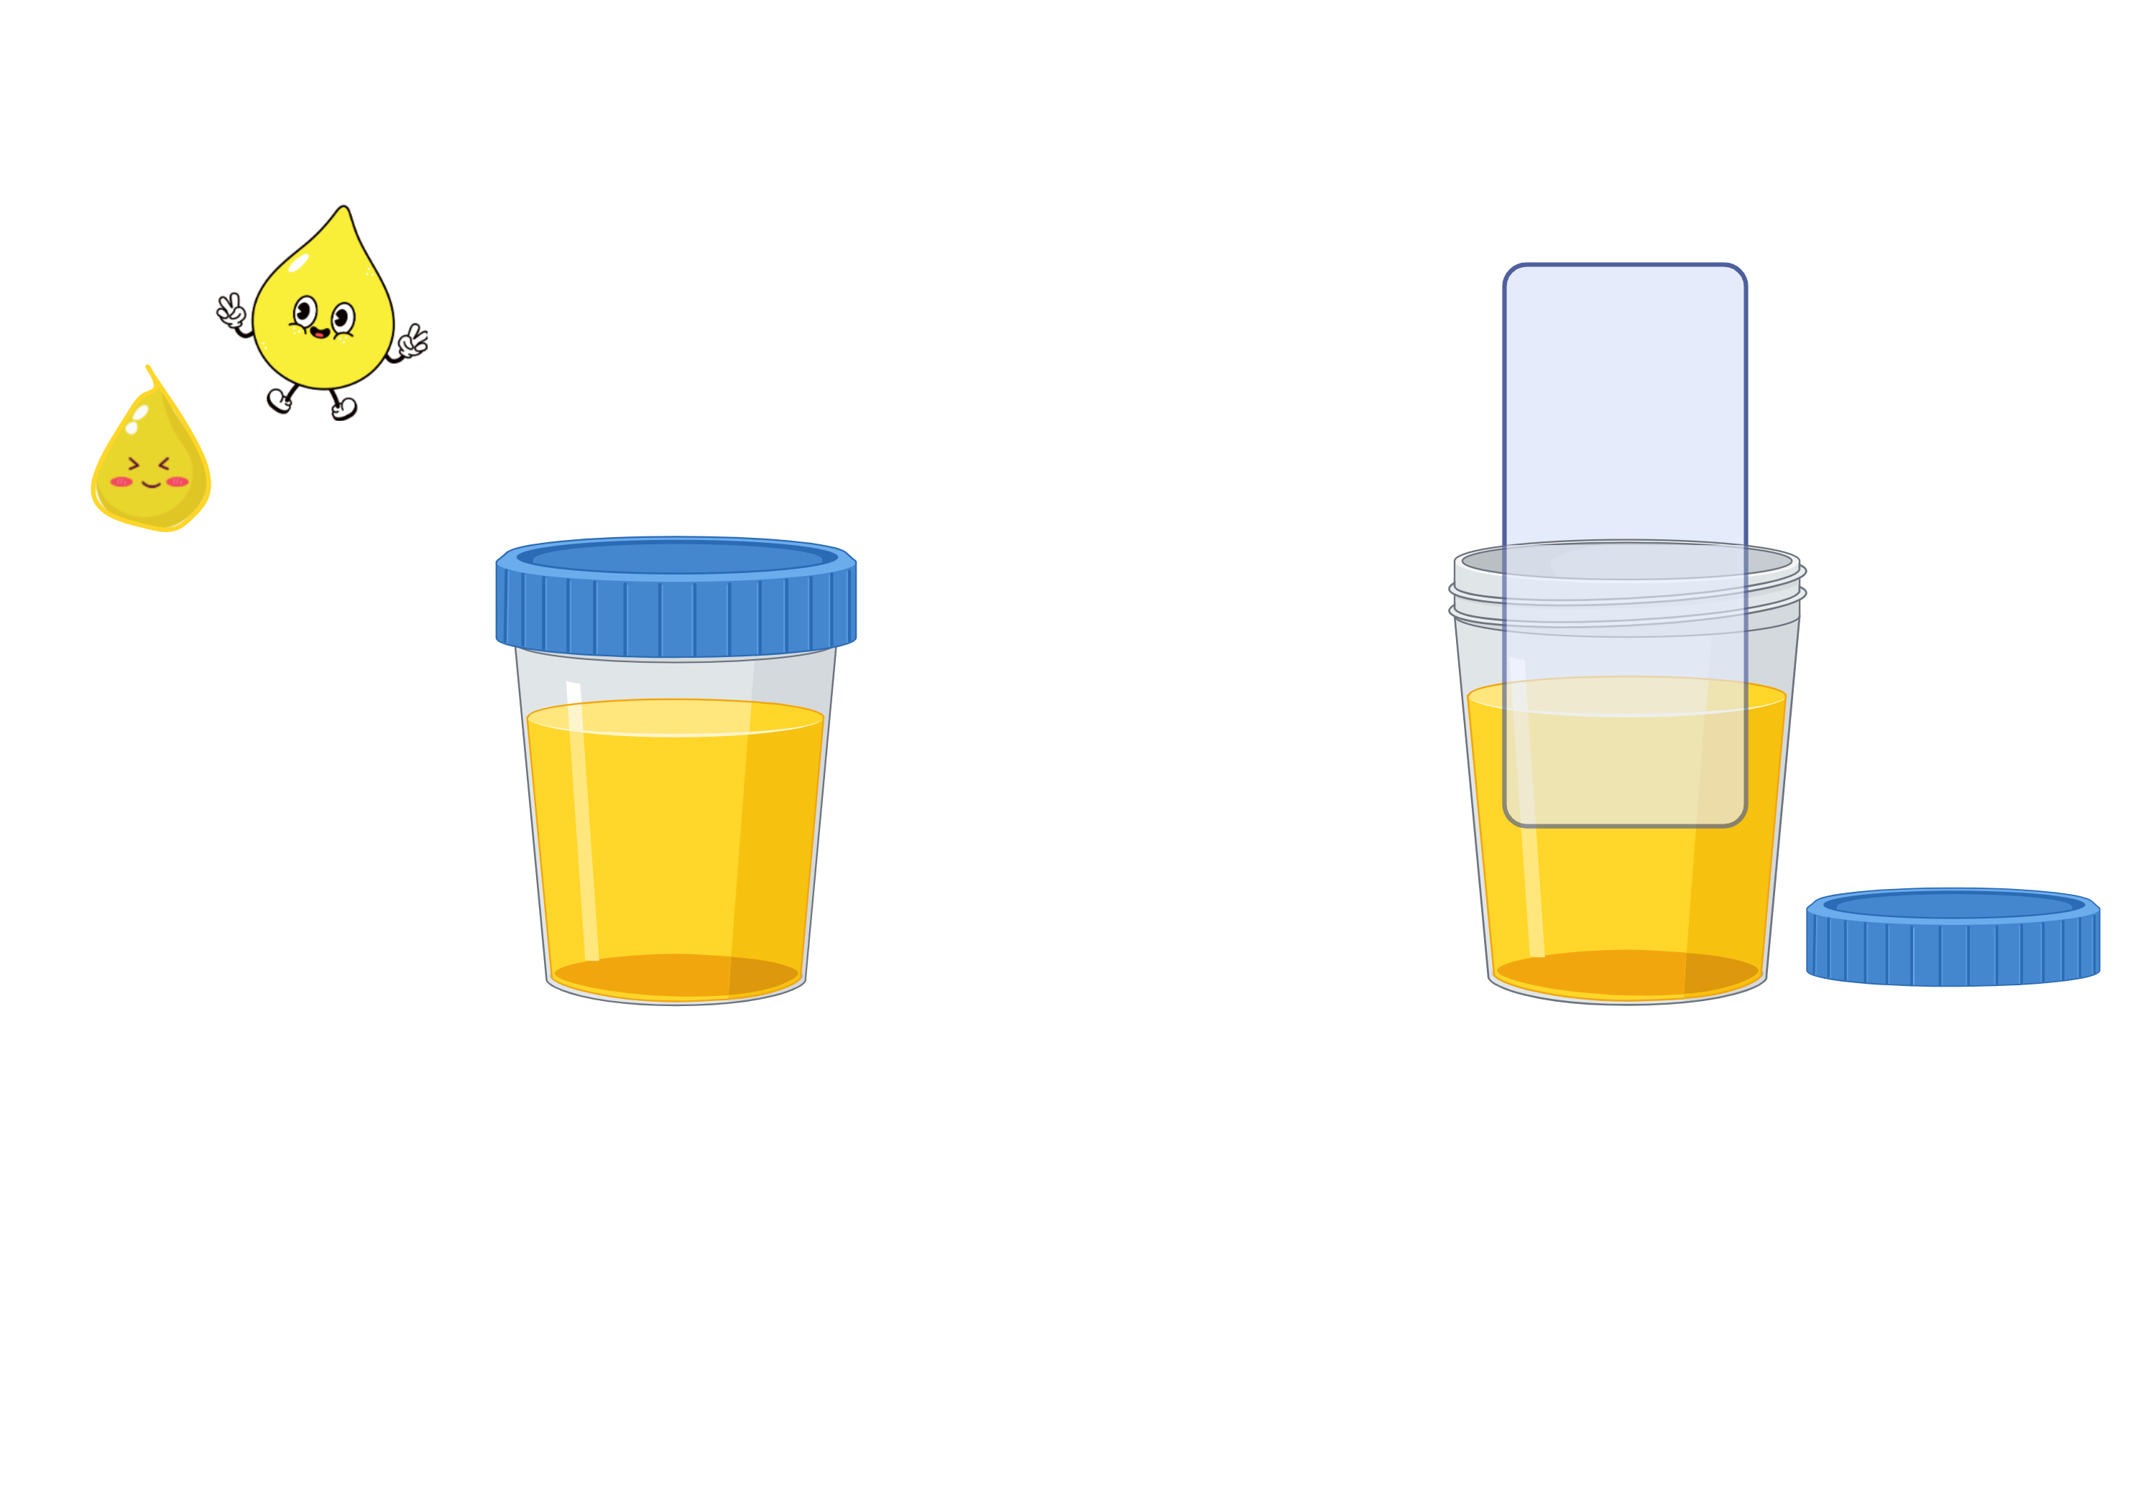
Liquid Urine
Dried
Urine
OR
Images Created with BioRender and Canva AI
Notes:
Liquid vs dried urine

Slide 42
Liquid Urine
Collection
  Pee in a cup
  Aliquoting samples
  Freezing (-80°C) and storage
Validity
  Gold Standard
Notes:
Newman M, Curran DA. Reliability of a dried urine test for comprehensive assessment of urine hormones and metabolites. BMC Chem. 2021;15(1):18. Published 2021 Mar 15. doi:10.1186/s13065-021-00744-3
Comparison of mass spectrometry identification of reproductive hormones and organic acid:
1) dry vs. liquid spot urine: Reproductive hormone results from dried and liquid urine were in excellent agreement with intraclass correlation coefficients (ICCs) greater than 0.90; comparison of dried to liquid urine for organic acids showed good to excellent agreement (ICC range: 0.75 to 0.99).
2) 24-hour urine vs. 4 dried spot urines: Comparison between the 4-spot urine collection and 24-h urine collection methods showed excellent agreement (ICC > 0.9) for 14 of the 17 urine metabolites and good agreement for the others (ICC 0.78 to 0.85) with no systematic differences between the two methods of collection.
Newman M, Curran DA, Mayfield BP. Dried urine and salivary profiling for complete assessment of cortisol and cortisol metabolites. J Clin Transl Endocrinol. 2020;22:100243. Published 2020 Nov 27. doi:10.1016/j.jcte.2020.100243
Essentially the same study as above, but looking at measurements of cortisol and cortisol metabolites
Results: Near ideal consistency was observed between liquid and dried urine for measures of total urine free cortisol, total urine cortisone, and total cortisol metabolites (n = 20; ICCs = 0.99, 0.97 and 0.96, respectively). Good to excellent consistency was observed between the 4-spot method and the 24-hour collection (n = 28; ICCs = 0.89, 0.95 and 0.92, respectively). In mixed model analysis, no difference was seen in the diurnal pattern of cortisol between salivary and urinary free cortisol (n = 68; P = 0.83).
Dutch test not FDA-approved for specific tests. No independent research on efficacy found.
ZRT dried urine testing not yet FDA-approved. No peer-reviewed studies on efficacy.

Slide 43
Dried Urine
Collection
  Similar to liquid collection
  Easy to transport
  Cheaper to store
  Stability at room temperature
    Long term storage -80°C
Validity
  No independent test for efficacy found
Newman and Curran BMC Journal 2020 & 2021​
Notes:
cite lydia's studies

Slide 44
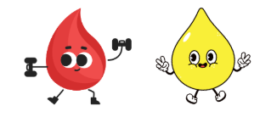
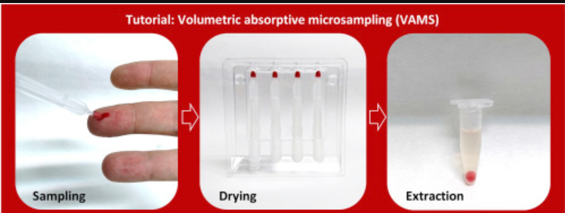
Dried Biosampling
Lamond et al. Journal of Clinical Lab. Analysis 2024
Protti et al. Analytica Chimica Acta 2019
Pro
Con
Cost saving
24 hour urine collection
Overcome participation bias
At home test
  Remote participants
  Conduct test on your own time
    During flares
    No time off work
Mixed results for sample recovery
Sampling devices poor quality by 32% compared to filter paper 6%
Mixed methodology

Slide 45
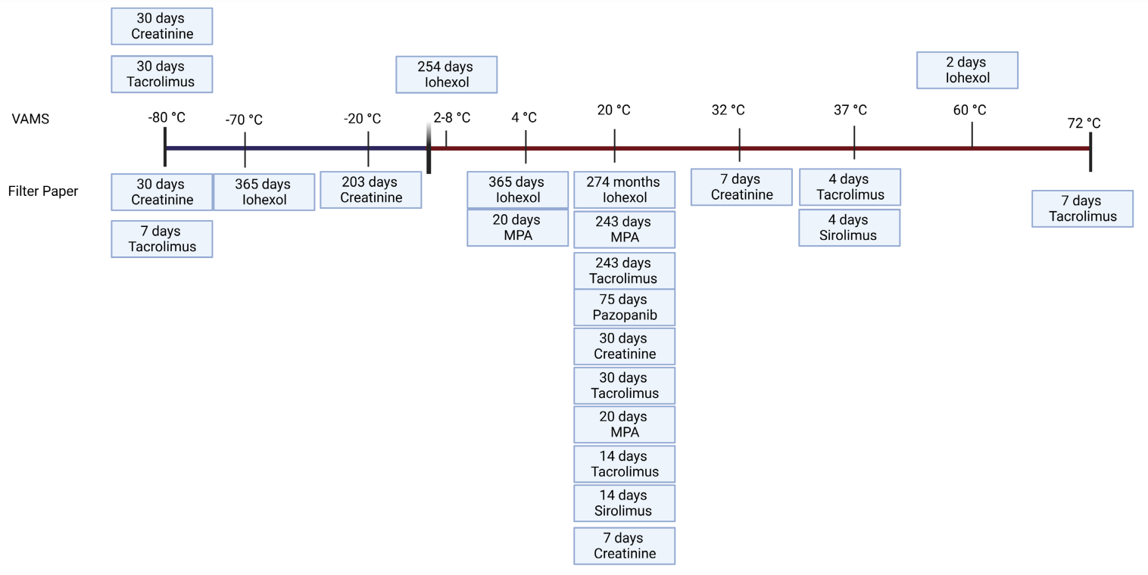
Stability of Analytes
Lamond et al. Journal of Clinical Lab. Analysis 2024
VAMS – Volumetric absorptive microsampling devices

Slide 46

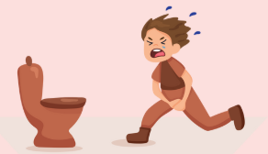
What is best for researchers?
Lab partnership
Type of urine collection required
  24 hour vs single time point
Cost of tests
Pediatric population
  (n=28) 50% preferred dried blood; 42% blood draw; 8% uncertain
Remote study
  Large studies, easy transport
  Comparable to liquid urine
Martial et al. Ther Drug Monit 2017
Morohashi et al. Pediatrics International 2021
Newman and Curran BMC Journal 2020 & 2021

Slide 47
Glyphosate - MADDY Study
Herbicide: kills unwanted plants
Residues on food which lead to low dose long term exposure (LDLT)
Elevated levels in children (CDC 2022)
Unknown impact of LDLT in children
Castilo et al. International Journal of Molecular Sciences 2022
Walsh et al. Gut Microbes 2023
Images Created with BioRender

Slide 48
Glyphosate
24-hour urine collection is best
Morning collection is second best
Toxicology Profile for Glyphosate Ch. 3, 2020
Notes:
Kids running to bathroom
Jar of urine collection
citations

Slide 49
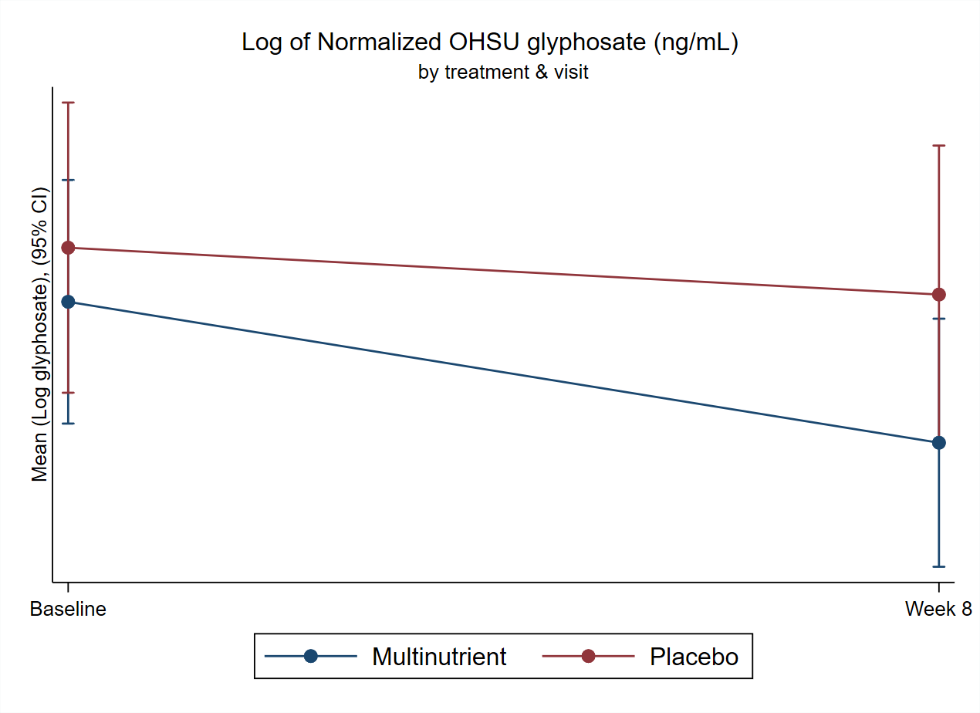
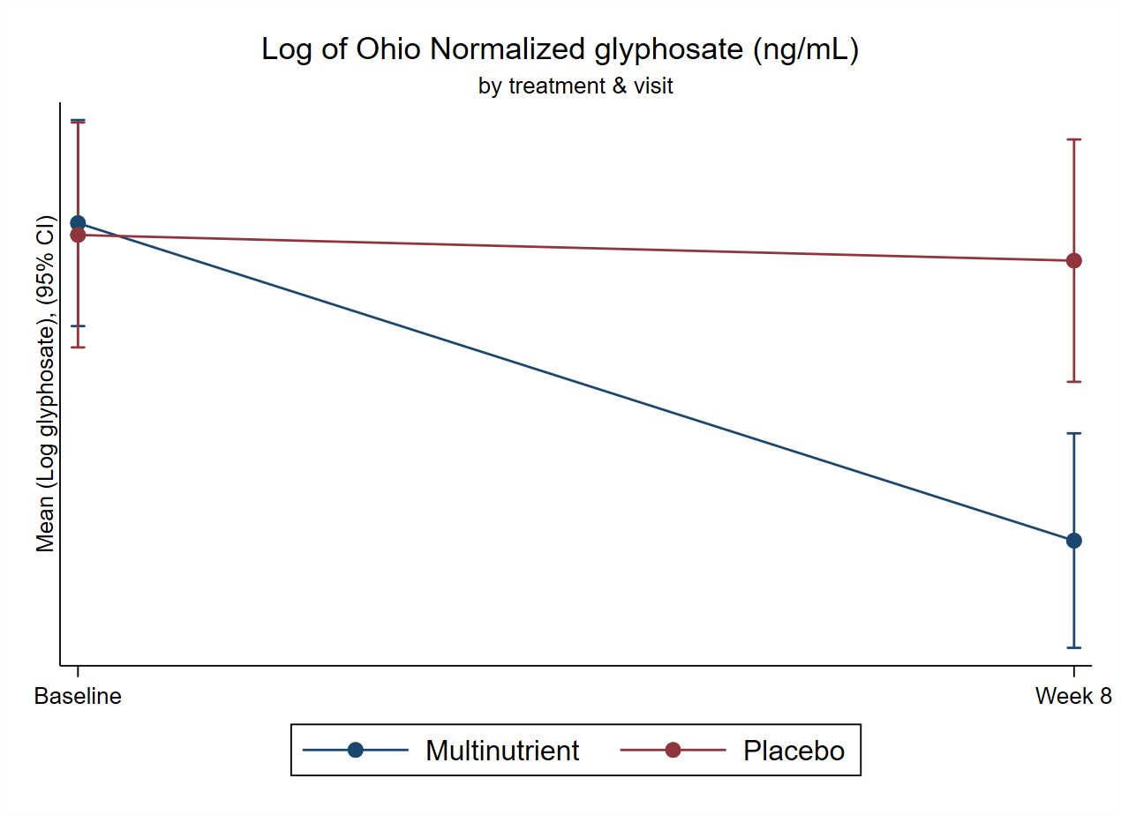
Results

Slide 50


Liquid Urine
Dried
Urine
OR
Convenient for family and researchers
Mixed methods/reliability
Gold Standard
Reliable Methods
Burdensome to store and transport
Images Created with BioRender and Canva AI
Notes:
Liquid vs dried urine

Slide 51




Acknowledging our funders
  In the US: Private philanthropy; Gratis Foundation, grants: 5R90AT00892403 through National University of Natural Medicine (NUNM), NCCIH: T32 AT002688
  In Canada: Nutrition and Mental Health Research Fund, administered by the Calgary Foundation
FDA IND#127832
Health Canada Control #207742
NCT03252522
Notes:
Researchers, clinicians, and student’s donated time

Slide 52
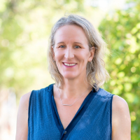
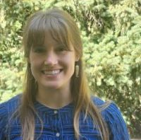

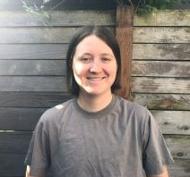
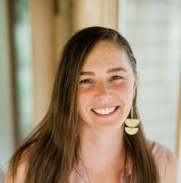




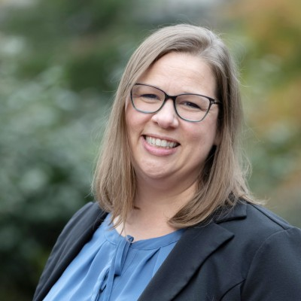
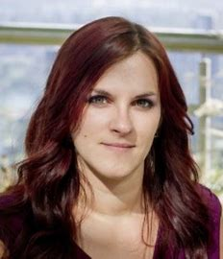
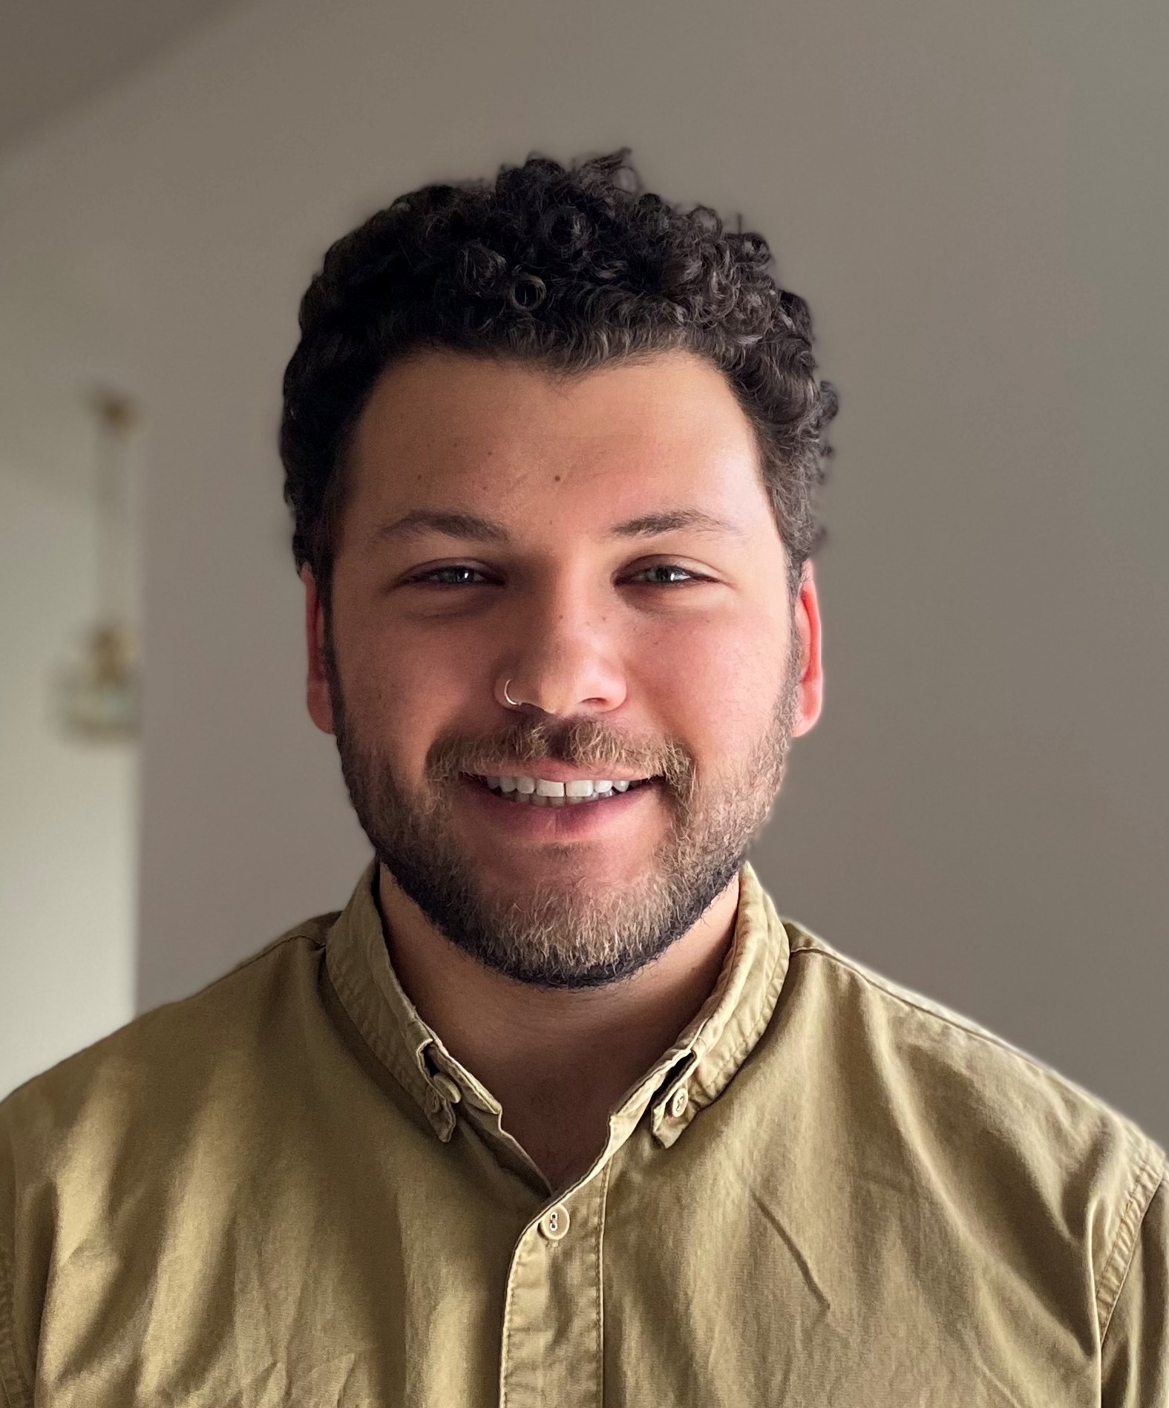
Thank You
Not Pictured, but equally appreciated: The Pacific Northwest National Laboratory – Ryan McClure, PhD and Sneha Couvillion, PhD; University of Southampton - Jon Swann, PhD; OHSU Volunteer- Alanna Walsh, ND; Health Research Institute - John Fagan, PhD
SNACK Lab at OHSU
Jeni Johnstone, PhD Hayleigh Ast, ND Taryn Machingo, ND, MS Lydia Norby-Adams, BA Alisha Bruton, MS, ND Priya Srikanth, MS
University of Lethbridge: Brenda Leung, ND
Ohio State University: Eugene L. Arnold, MD, Med, Irene Hatsu, PhD, Lisa Robinette, MS; Not Pictured: Chris Zhu, PhD, Shiqi Zhang, PhD, Xinru Pang
OHSU: Dept of Medical Informatics and Clinical Epidemiology: Lisa Karstens, PhD, Matthew Hammer, MS

Slide 53

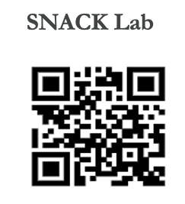
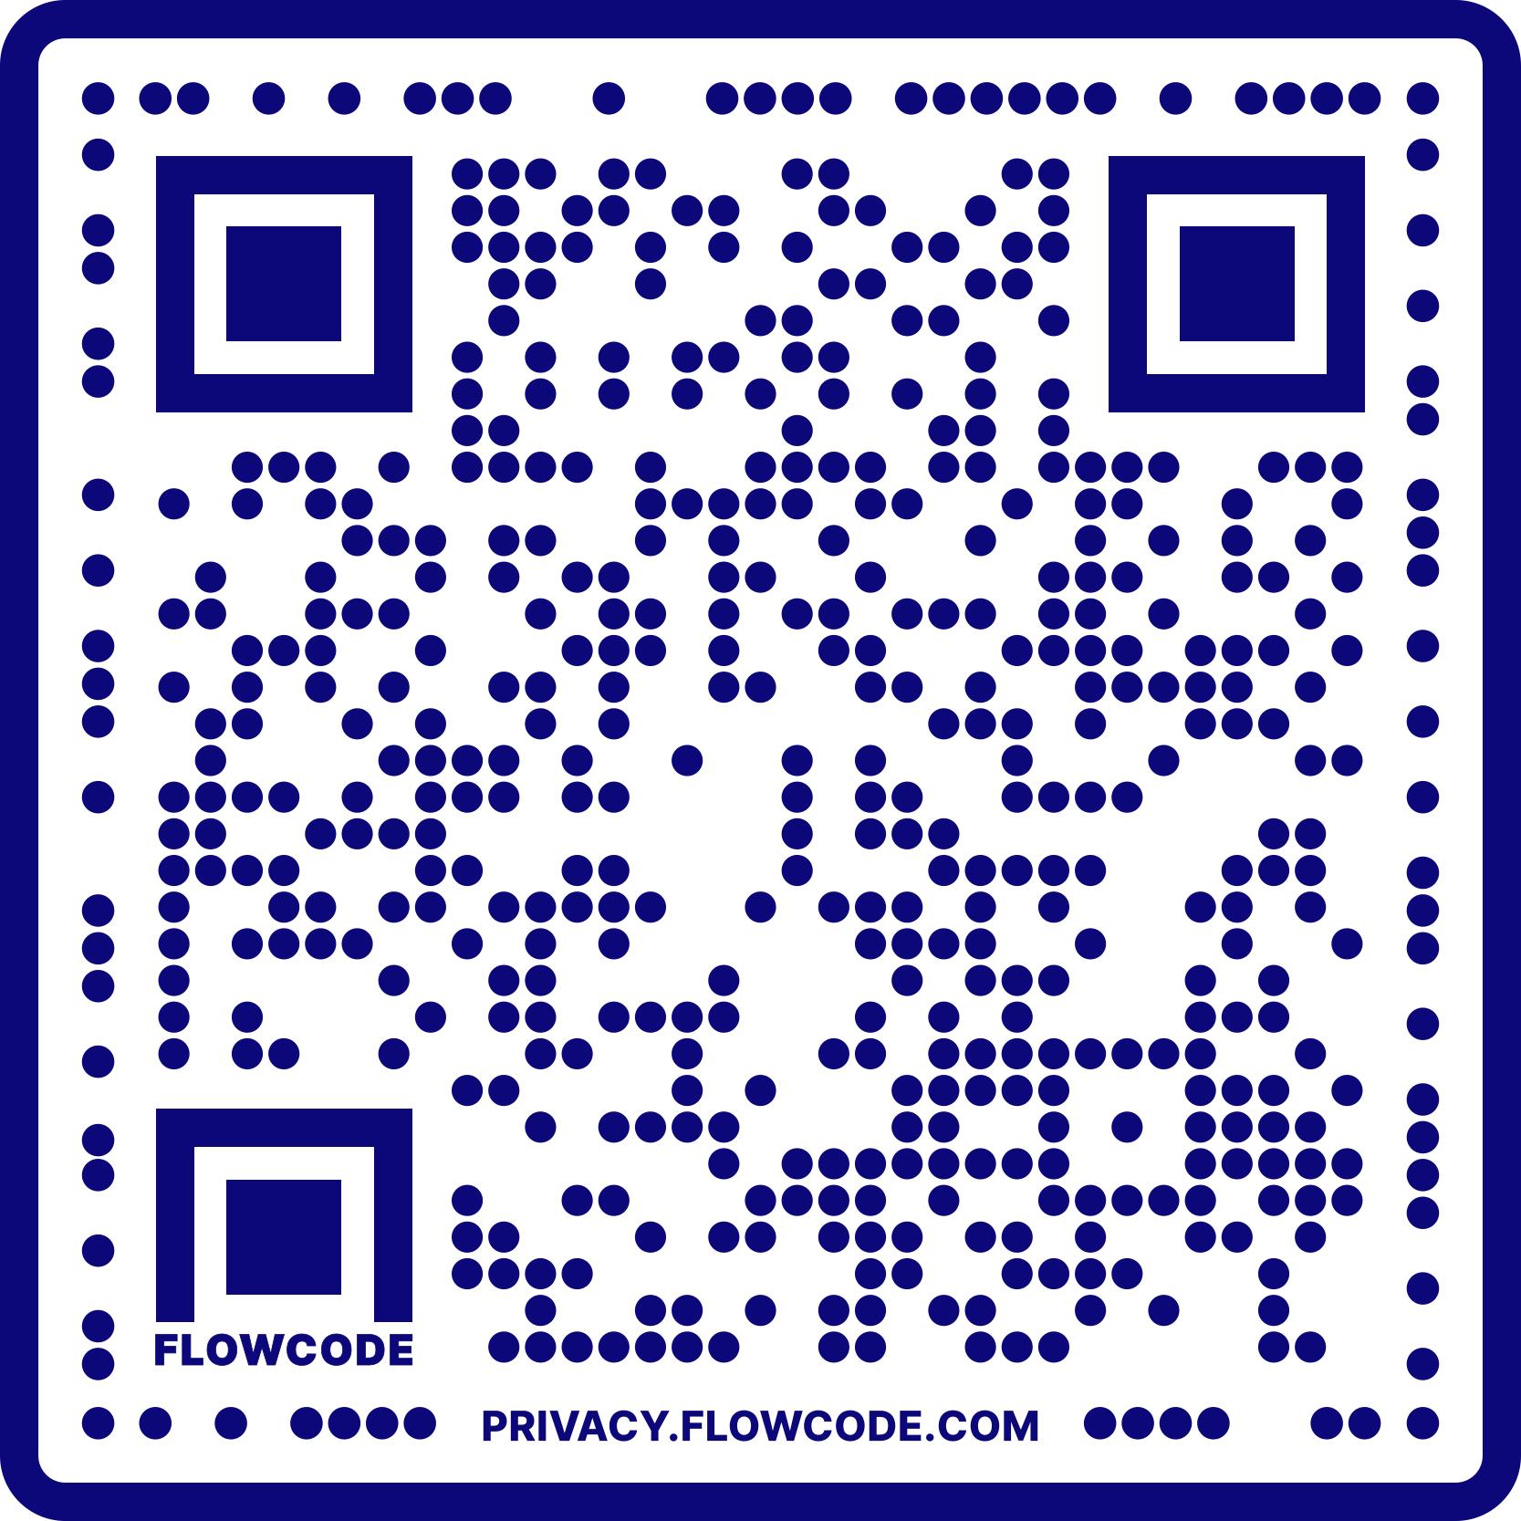
Discussion
References:
SNACK Lab:

